Slide 1
Energy Consumption Prediction
- Hitesh Paighan

Slide 2
Contents
Problem Statement
Data Cleaning
Data Visualization
Model Building
Data and Model analysis
Data Forecasting

Slide 3
Problem Statement
In this project, the goal is to develop a predictive model that can forecast future energy consumption values for a power grid based on historical consumption patterns. The dataset contains time series data of energy consumption recorded at regular intervals

Slide 4
Data Cleaning
Loaded Household Power Consumption Data.
Date and Time: Useful for time-series analysis, trend identification, and temporal aggregations (e.g., daily, weekly consumption).
Global Active Power: A primary feature for assessing energy consumption. Trends in this feature can help identify peak usage times or inefficiencies.
Global Reactive Power: Though not directly contributing to active energy consumption, it is crucial for understanding power quality and the household's impact on the grid.
Voltage: Can help identify potential issues like under-voltage or over-voltage scenarios that might damage appliances or reduce efficiency.
Global Intensity: Complements voltage and power features, offering insights into how current consumption correlates with the active and reactive power.
Sub-Metering 1, 2, 3: These granular features enable pinpointing energy use within specific household zones or systems. Useful for targeted energy-saving strategies.

Slide 5
Data Cleaning
Handled missing values:
The dataset consists of multiple columns, including both numerical and object
To get accurate Null values , first we have to convert columns which are in string to numericals
Columns that represent numerical values but stored as strings are converted using 'to_numeric'
Feature Engineering:Created holiday and sunlight indicators.
Convert the tuple to a date object
Converting tuple (year, month, day) to date object
Apply the function to the 'Date' column (which is in (year, month, day) format)
Assuming 'time' is a tuple (hour, minute)
Sunlight is present between 06:00 and 18:00
Apply the function to the 'Time' column and create 'Sunlight' column

Slide 6
Data Visualization
1.How has 'Global_active_power' changed or trended over time?
2. What is the nature of the relationship between 'Global_active_power' and 'Voltage’?
3. How does 'Global_intensity' fluctuate across different hours of the day?
4.What is the average 'Sub_metering' value on a daily basis?
5. How does 'Global_reactive_power' differ on holidays compared to regular days?

Slide 7
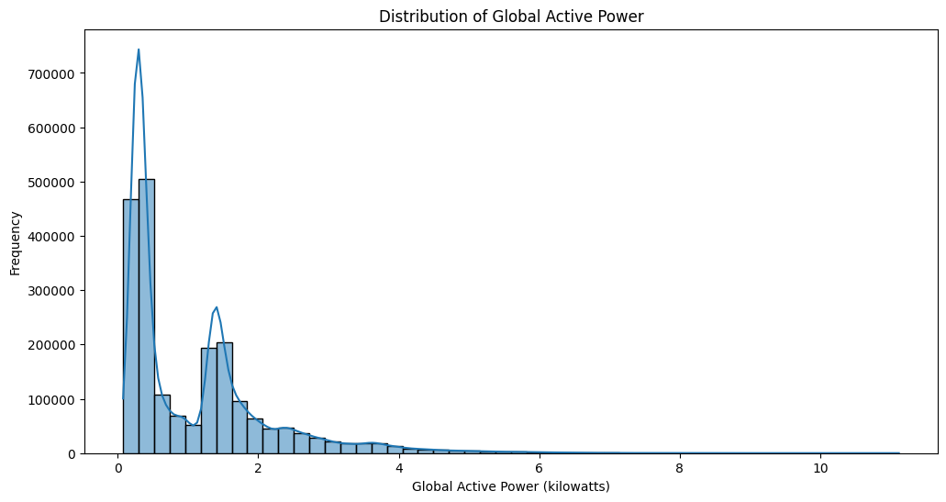
1.How has 'Global_active_power' changed or trended over time?
1.Values above 2 kilowatts are less frequent, and values above 6 kilowatts are very rare. This could imply that high power consumption is either uncommon or occurs only under specific conditions.
2.There is a significant peak around 0.2–0.4 kilowatts, indicating that the most frequent usage level falls within this range. This suggests that low levels of active power are common in this dataset

Slide 8
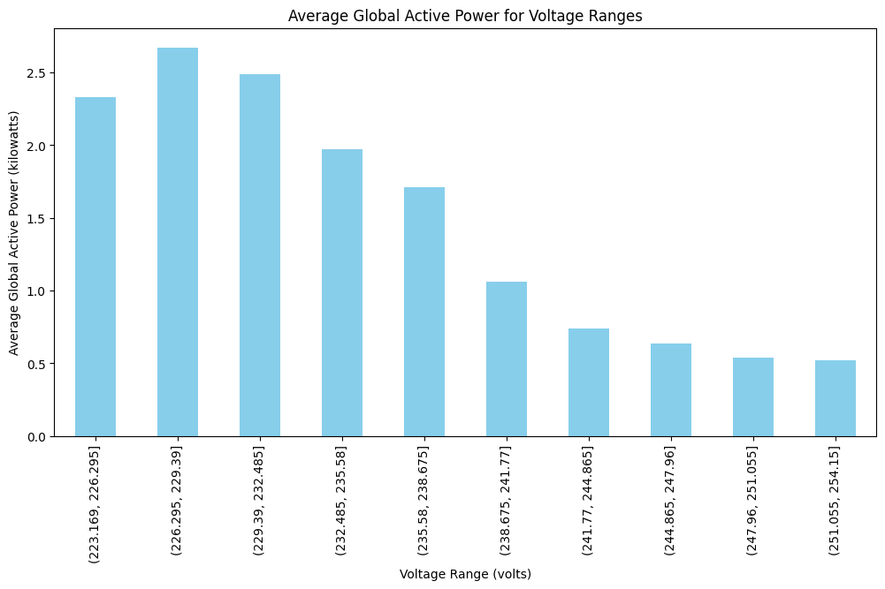
2. What is the nature of the relationship between 'Global_active_power' and 'Voltage’?
1.The voltage ranges from around 223.169 to 232.485 volts show the highest levels of average Global Active Power, with values above 2 kilowatts. This suggests that lower voltages are associated with higher power draw.
2.The chart reveals a general trend where the average Global Active Power decreases as the voltage range increases. In lower voltage ranges the average Global Active Power is higher, while in higher voltage ranges the average power consumption is lower.

Slide 9
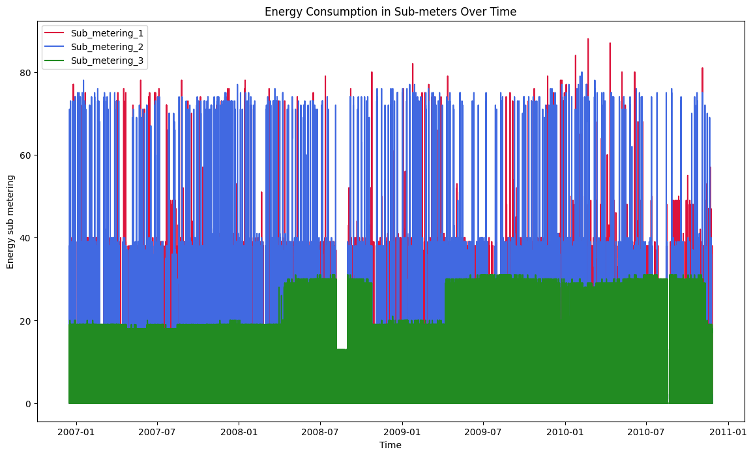
3. How does 'Global_intensity' fluctuate across different hours of the day?
1.There is a high frequency of energy usage fluctuations, with frequent spikes across all sub-meters. This indicates intermittent or possibly highly variable energy consumption.
2.Sub_metering_1 and Sub_metering_2 seem to show a similar pattern of high-frequency fluctuations.
3.Sub_metering_3 shows fewer spikes, with more consistent values over time.

Slide 10
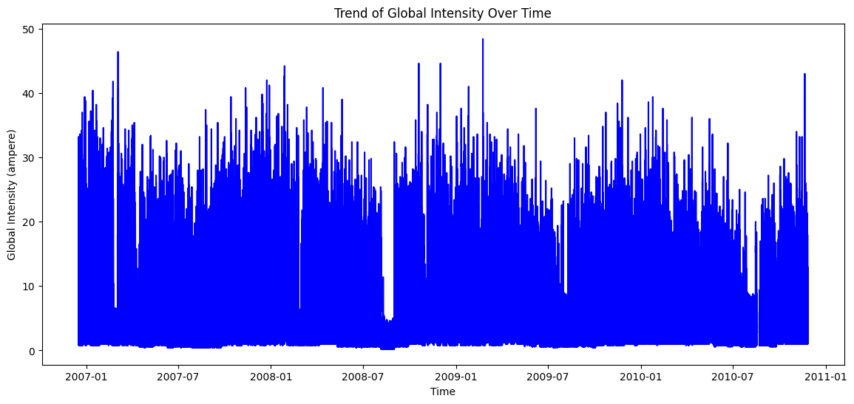
4.What is the average 'Sub_metering' value on a daily basis?
1.The global intensity fluctuates significantly throughout the timeframe, showing a pattern of peaks and troughs.
2.There seem to be periodic spikes, possibly corresponding to seasonal changes or other recurring events that increase global intensity.
3.Although there is high variability, there may be a cyclic or seasonal trend to the pattern, with the frequency of peaks and valleys potentially following a regular cycle.

Slide 11
Model Building

Slide 12
Steps in model Building
Splitting Data
Models Used
Training Set: Used to teach the model to recognize patterns in the data.
Testing Set: Evaluates how well the model generalizes to unseen data. Ensures that the model is not overfitting (memorizing) the training data.
Linear Regression :A simple regression technique modeling a straight-line relationship between independent variables and a target, minimizing residual errors for predictions.
Lasso Regression : Lasso adds L1 regularization, shrinking less important coefficients to zero, improving feature selection and preventing overfitting in high-dimensional datasets.
Ridge Regression : Ridge uses L2 regularization, penalizing large coefficients, reducing multicollinearity impact, and enhancing model stability without eliminating features completely.

Slide 13
Data and Model analysis
The Root Mean Squared Error (RMSE) is a commonly used metric for evaluating regression models. It measures the average magnitude of the errors between predicted values and actual values.
R^2 score, or Coefficient of Determination, measures how well the regression model explains the variance in the target variable. It indicates the proportion of the total variation in the target variable that is explained by the model.
Mean Absolute Error (MAE) is a statistical metric used to measure the average magnitude of the errors in a set of predictions, without considering their direction (positive or negative). It represents how far the predictions are, on average, from the actual values.
Linear Regression | Lassso Regression | Ridge Regression
RMSE: 0.04 | RMSE: 0.05 | RMSE: 0.04
R^2 : 1.00 | R^2 : 1.00 | R^2 : 1.00
MAE: 0.03 | MAE: 0.04 | MAE: 0.03

Slide 14
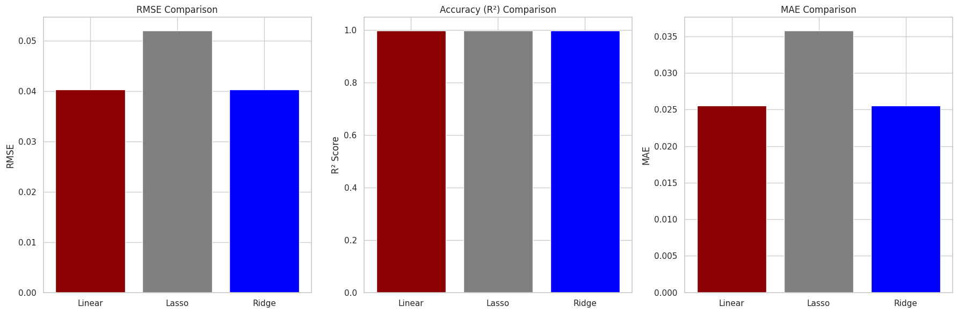
Comparing Accuracies
Linear Regression and Ridge Regression perform almost identically, with both having very low RMSE and MAE values. They both make accurate predictions with minimal error. Lasso Regression has slightly higher RMSE and MAE values, indicating it has slightly more prediction error than the other two models, although the difference is small.

Slide 15
Data Visualization
1.How has 'Global_active_power' changed or trended over time?
2. What is the nature of the relationship between 'Global_active_power' and 'Voltage’?
3. How does 'Global_intensity' fluctuate across different hours of the day?
4.What is the average 'Sub_metering' value on a daily basis?
5. How does 'Global_reactive_power' differ on holidays compared to regular days?

Slide 16
Why certain models have good accuracy and others don't?
Linear Relationships in Data
Strong Linear Relationships: Linear Regression, Ridge, and Lasso work well when the data has a clear straight-line relationship between features and target. These models are simple, efficient, and suitable for straightforward data.
Impact of Regularization
Ridge Regression: Adds a penalty for large coefficients to stabilize the model and prevent overfitting, improving performance slightly.
Lasso Regression: Applies a penalty that can shrink some coefficients to zero, effectively removing less important features. This improves simplicity but may increase error if useful features are removed.
Low Complexity and High Predictive Power
Clean Data and Good Features: Linear models perform well with low noise and relevant features, delivering accurate predictions.
Avoiding Overfitting: These models focus on the most important patterns without being overly complex, ensuring generalization to new data.

Slide 17
Data Forecasting

Slide 18
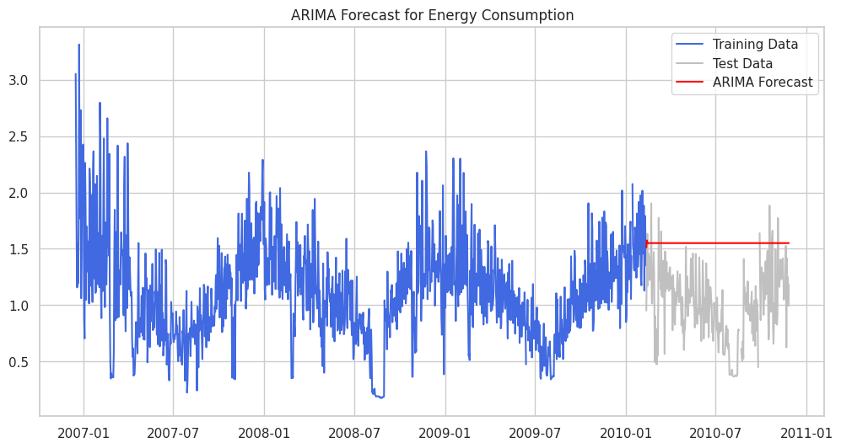
ARIMA Model
An autoregressive integrated moving average, or ARIMA, is a statistical analysis model that uses time series data to either better understand the data set or to predict future trends.
ARIMA works well for time series data that shows stationarity after differencing, and it captures patterns based on past values and errors.

Slide 19
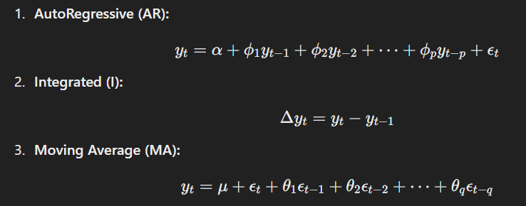
ARIMA Model - MATHEMATICS

Slide 20
Prophet model
Prophet is a time series forecasting tool developed by Facebook, suitable for data with strong trends and seasonality.
Prophet is an open-source time series forecasting tool developed by Facebook. It handles trends, seasonality, and holidays automatically, making it suitable for data with irregular intervals or missing values. Easy to use, Prophet is robust against outliers and effective for business applications, such as demand forecasting or sales predictions. It supports customizations for advanced forecasting needs.
Prophet works by breaking time series data (like sales, temperatures, or website traffic over time) into three main parts:
Trend: It looks for the overall direction of the data—whether it’s going up, down, or staying steady over time.
Seasonality: It identifies repeating patterns, like higher sales during holidays or weekends.
Holidays: It accounts for special days that might cause spikes or drops, like festivals or promotions.

Slide 21
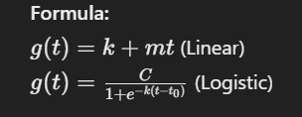

Prophet model- Mathematics
Prophet combines these pieces to predict future values. If your data is messy or has gaps, Prophet can still handle it, making it a flexible and easy-to-use tool for forecasting.
Trend
Linear Growth: Models a steady increase or decrease in data over time.
Logistic Growth: Models saturation points where growth slows as it approaches a cap.
Formula:
Seasonality
Captures repeating patterns in the data, such as daily, weekly, or yearly cycles. Additive or multiplicative seasonal effects.
Formula :

Slide 22

Prophet model- Mathematics
Final model
g(t): Trend component.
s(t): Seasonality component.
h(t): Holiday effects.
ϵ t​: Error term.
Formula :

Slide 23
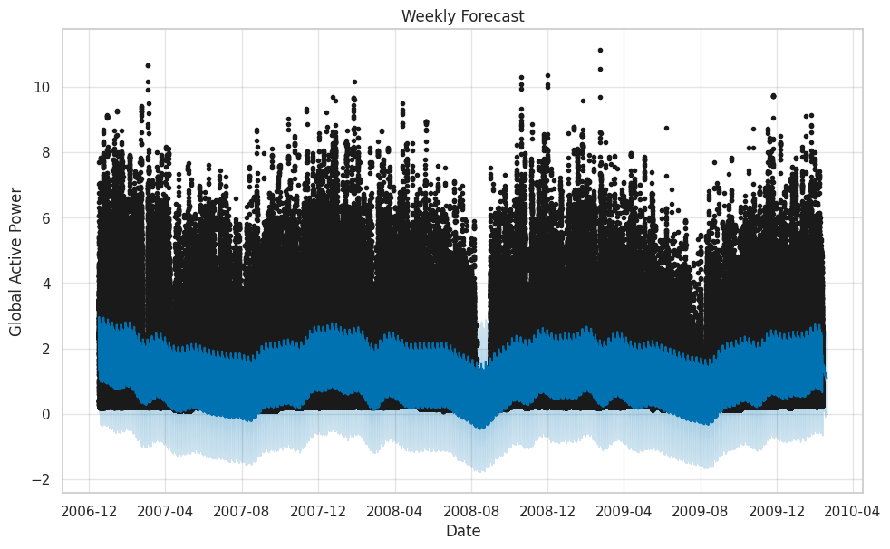
Weekly forecast
Energy consumption was noticeably higher on weekdays compared to weekends, reflecting common household routines and industrial work schedules. This pattern highlights increased activity during weekdays, such as work hours and production processes. Additionally, peak usage times within the week, such as mornings and evenings when energy demand typically surges, were accurately identified, providing valuable insights into consumption trends.

Slide 24
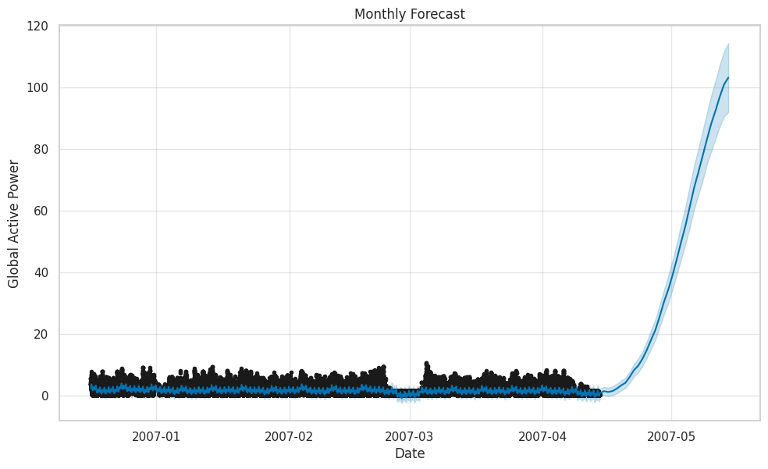
Monthly forecast
The forecast effectively identified recurring patterns, such as slight decreases in energy consumption on weekends and a noticeable increase in usage mid-month. These trends were likely influenced by routine behavior and scheduling. Additionally, monthly patterns often highlighted the combined impact of weather conditions and social factors, such as seasonal changes or events, on overall energy demand.

Slide 25
Observation
Trend: Reflects consistent changes over time, indicating either growth or decline in the system's behavior. For example, in energy forecasting, a trend may signal an increase in energy demand due to population growth or infrastructure development.
Seasonality:
Yearly: Highlights recurring energy consumption patterns across years, often due to seasonal climate changes or annual events.
Daily: Captures diurnal variations in energy usage, influenced by human activities (e.g., peak usage during daytime).

Slide 26
THANK YOU

